Slide 1
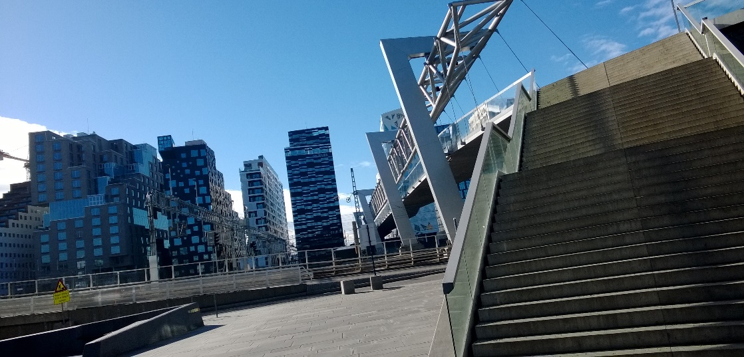

SharePoint as a Service Delivery Platform #SPSOslo
SharePoint Saturday
Oslo 2015
Ryan Yates
October 17th, 2015
Notes:
Template may not be modified
Twitter hashtag: #spsoslo for all sessions

Slide 2

SharePoint as a Service Delivery Platform
Ryan Yates
@ryanyates1990
SharePoint IT Pro at University of Manchester

Slide 3



Thanks to our Sponsors
Platinum
Gold
Silver
Raffle
SharePint

Slide 4
About me
Ryan Yates – 25 – Proud father to Aaron 6 & Kyra 22 months
Currently
MCP – Windows XP – 70-271
Planned
MCSA Office 365
MCITP SharePoint 2010 & MCSE SharePoint 2013
MCSA Server 2008 -> Server 2012
MCSE Private Cloud

Slide 5
Tweet me
@ryanyates1990
Any Photos or Questions about this now or in future

Slide 6
Professional Background
Currently
SharePoint Applications/Implementation Analyst - University Of Manchester
Previously
SharePoint User Support Services Engineering Consultant – Barclays
Various Retail Jobs
Passion for all things IT related however predominantly been Microsoft Focused since Windows XP
SharePoint was my entry into IT
However PowerShell is my Secret love
“Spend less time doing the same mundane tasks and spend more time pushing your knowledge in automation”
Simple Task Automation = Early DevOps implementation

Slide 7
Background to this Session
Tasks that take 2 or 3 minutes to do can take 3-4 days to get authorised and then actioned
IT is ALWAYS the blocker – Whether it be People or Processes
Items of work get lost in 1 persons Inbox
No mitigation plans in place for holidays/sickness result in project delays
Business users will bypass IT processes so that the work gets done – Dropbox is a common example
How can we get round this issue?
How can we make things easier?
How can we ensure that we have a robust and scalable method for service delivery ?

Slide 8
Service Delivery 101
What is Service Delivery?
Service Delivery can be simplified into 3 streams
Standard Work Requests – New Accounts , Mailboxes, SharePoint Sites, Virtual Servers (std)
Bespoke Work Requests – Small Variations to the above
Projects – New functionality implementations – CRM, Project Server, In-house Applications
Why should we worry about not delivering within our own environment?
Imagine the inability to withdraw cash or that Credit\Debit cards no longer existed or Online Shopping Sites didn’t exist – How would you cope day to day? – That is how the business users will continue to view IT – Behind the times inefficient and the LAST resort
So what can we look to do to mitigate these Issues?

Slide 9
Round the Room Votes!
Company size – Under 100 FTE’s = ?? 100 to 500 FTE’s = ?? 500 to 2500 FTE’s = ?? 2500-10000 FTE’s = ?? 10000+ FTE’s = ??
Do you have SharePoint?? Yes = ?? % No = ?? %
If yes then is it – 2003 = ?? 2007 = ?? 2010 = ?? 2013 = ?? Online = ?? Not Sure = ??

Slide 10
Demo

Slide 11



Questions?
@ryanyates1990
http://uk.linkedin.com/in/ryanyates90

Slide 12
Thanks to our Sponsors
Platinum
Gold
Silver
Raffle
SharePint

Slide 13
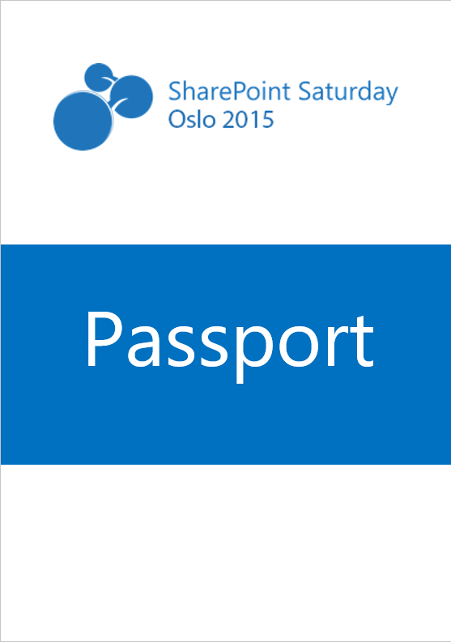


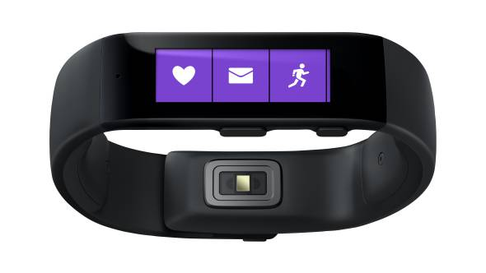
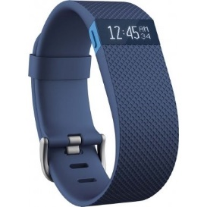
The SPSOslo Passport
Get stamps from all the sponsors, so make sure to visit them
Deposit the passport to enter the prize raffle
Good luck!

Slide 14

SharePint sponsored by
FREE BEER!
Make sure to get your voucher
Network and have fun with your colleagues and mingle with our great speaker lineup.

Slide 15
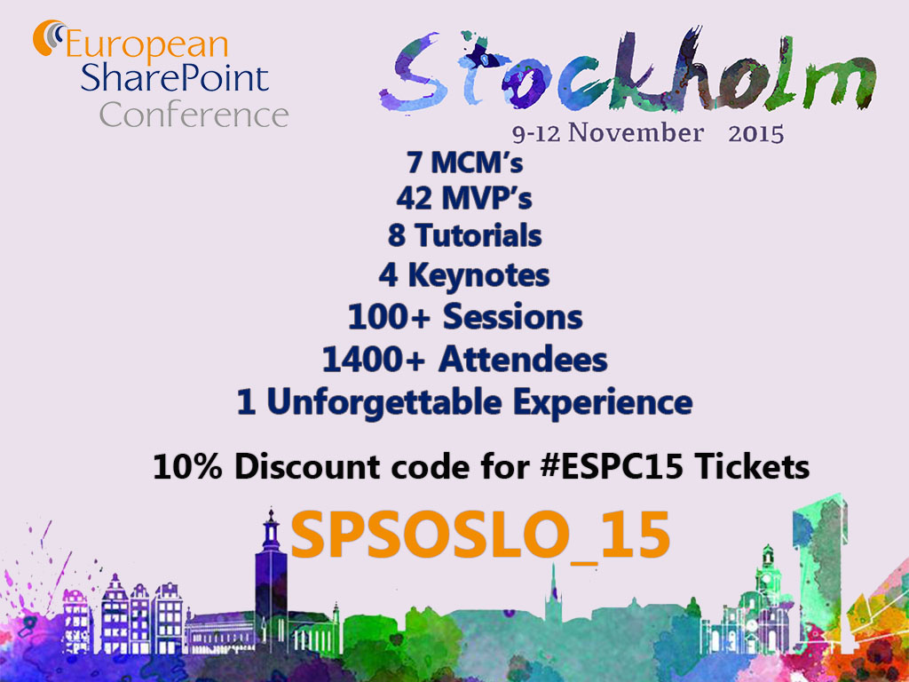

Slide 16
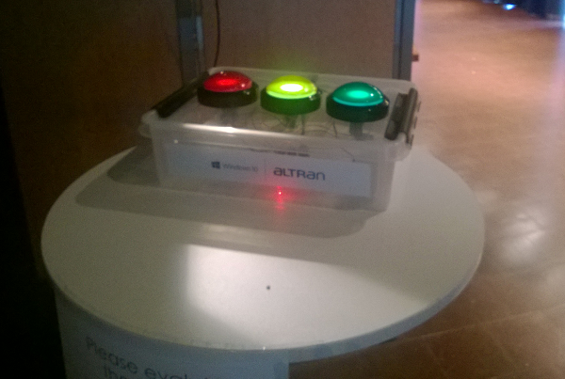
Remember to evaluate our sessions
They help us improve for SharePoint Saturday 2016!

